Slide 1
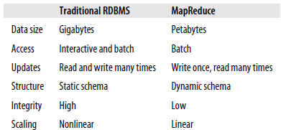
Why Hadoop?
Big Data!!
Storage
Analysis
Data management

Slide 2
Why Hadoop?
Big Data!!
Storage
Analysis
Data management

Slide 3
Advantages of Hadoop
Vast amounts of data
Economic
Efficient
Scalable
Reliable

Slide 4
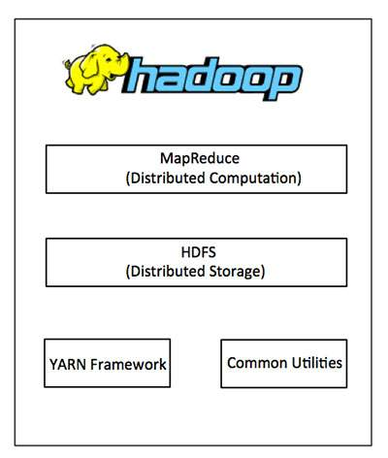
The Core Apache Hadoop Project
Hadoop Common:
Java libraries and utilities required by other Hadoop modules.
Hadoop YARN:
a framework for job scheduling and cluster resource management.
HDFS:
A distributed file system
Hadoop MapReduce:
YARN-based system for parallel processing of large data sets.

Slide 5
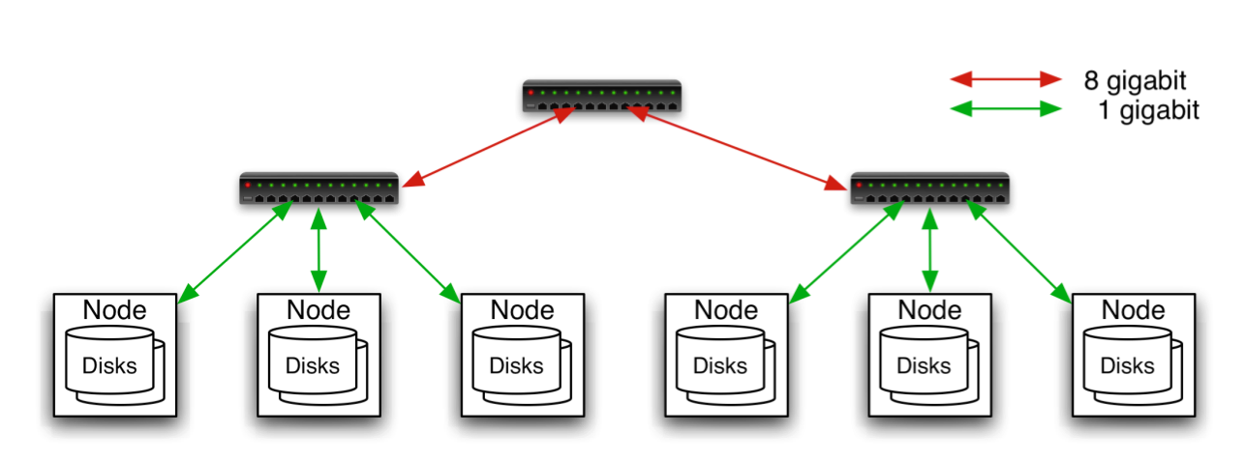
Hadoop Cluster
Typically in 2 level architecture
Nodes are commodity PCs
30-40 nodes/rack
Uplink from rack is 3-4 gigabit
Rack-internal is 1 gigabit
Aggregation switch
Rack switch

Slide 6
Hadoop Related Subprojects
Pig
High-level language for data analysis
HBase
Table storage for semi-structured data
Zookeeper
Coordinating distributed applications
Hive
SQL-like Query language and Metastore
Mahout
Machine learning

Slide 7
MapReduce Workflows
When data processing gets more complex, this complexity is generally manifested by having more MapReduce jobs, rather than having more complex map and reduce functions.
For more complex problems, it is worth considering a higher-level language than Map-Reduce, such as Pig, Hive, Cascading, Cascalog, or Crunch.
In other words, as a rule of thumb, think about adding more jobs, rather than adding complexity to jobs.

Slide 8
Unit Test
The map and reduce functions in MapReduce are easy to test in isolation.
For known inputs, they produce known outputs.
since outputs are written to a “Context” (or an OutputCollector in the old API), rather than simply being returned from the method call, the Context needs to be replaced with a mock so that its outputs can be verified.

Slide 9
Unit test for MaxTemperatureMapper

Slide 10
Cont…
The test is very simple: it passes a weather record as input to the mapper, then checks the output is the year and temperature reading.
The input key is ignored by the mapper, so we can pass in anything, including null as we do here.
To create a mock Context, we call Mockito’s mock() method (a static import), passing the class of the type we want to mock.
Then we invoke the mapper’s map() method, which executes the code being tested.

Slide 11
Finally, we verify that the mock object was called with the correct method and arguments, using Mockito’s verify() method.
Here we verify that Context’s write() method was called with a Text object representing the year (1950) and an IntWritable representing the temperature (−1.1°C).
Refer 156-161 pages

Slide 12
Unit tests with MRUnit
the MRUnit project (http://incubator.apache.org/mrunit/), which aims to make unit testing MapReduce programs easier.

Slide 13
Anatomy of a MapReduce Job Run
One can run a MapReduce job with a single method call: submit() on a Job object.
In releases of Hadoop up to and including the 0.20 release series, “mapred.job.tracker” determines the means of execution.
If this configuration property is set to local, the default, then the local job runner is used. This runner runs the whole job in a single JVM.
It’s designed for testing and for running MapReduce programs on small datasets.
In Hadoop 0.23.0 a new MapReduce implementation was introduced.
The new implementation (called MapReduce 2) is built on a system called YARN

Slide 14
Classic MapReduce (MapReduce 1)
A job run in classic MapReduce is shown in the figure.
At the highest level, there are four independent entities:
The client, which submits the MapReduce job.
The jobtracker, which coordinates the job run. The jobtracker is a Java application whose main class is JobTracker.
The tasktrackers, which run the tasks that the job has been split into. Tasktrackers are Java applications whose main class is TaskTracker.
The distributed filesystem which is used for sharing job files between the other entities.

Slide 15
Job Submission
The submit() method on Job creates an internal JobSummitter instance and calls submitJobInternal() on it as shown in the above figure above.
Having submitted the job, waitForCompletion() polls the job’s progress once a second and reports the progress to the console if it has changed since the last report.
When the job is complete, if it was successful, the job counters are displayed.
Otherwise, the error that caused the job to fail is logged to the console.

Slide 16
Cont…
The job submission process implemented by JobSummitter does the following:
Asks the jobtracker for a new job ID by calling getNewJobId() on JobTracker.
Checks the output specification of the job.
Computes the input splits for the job. If the splits cannot be computed, because the input paths don’t exist, for example, then the job is not submitted and an error is thrown to the MapReduce program.
Copies the resources needed to run the job, including the job JAR file, the configuration file, and the computed input splits, to the jobtracker’s filesystem in a directory named after the job ID.

Slide 17
The other steps are:
Job Initialization
Task Assignment
Task Execution
Streaming and Pipes
Progress and Status Updates

Slide 18
Introduction to Hadoop Yarn

Slide 19
Yarn
YARN is the prerequisite for Enterprise Hadoop
providing resource management and a central platform to deliver consistent operations, security, and data governance tools across Hadoop clusters.

Slide 20
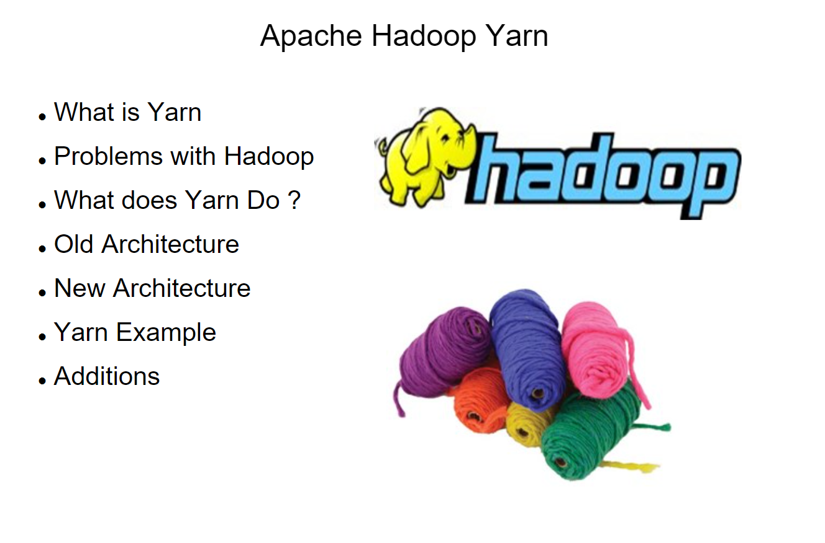

Slide 21
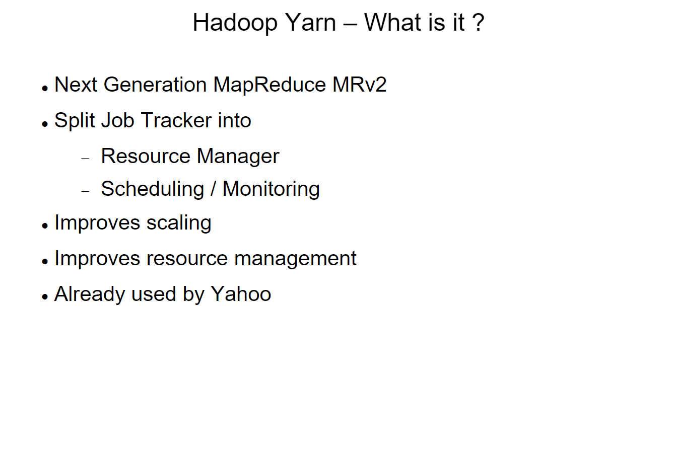

Slide 22
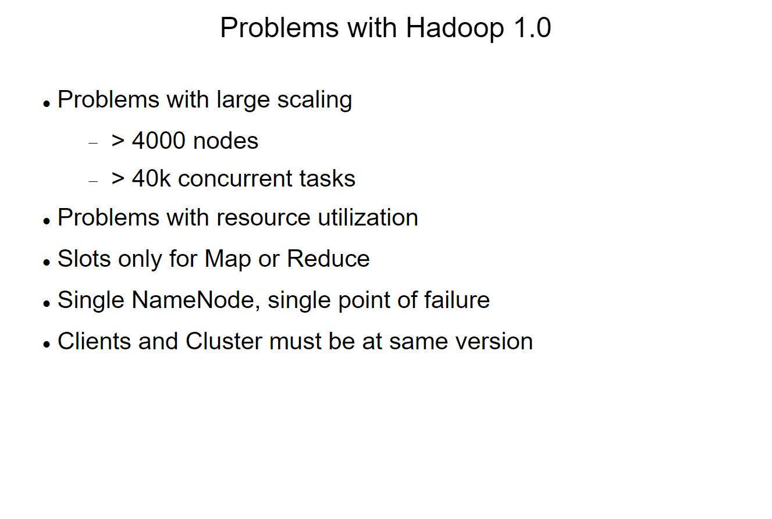

Slide 23
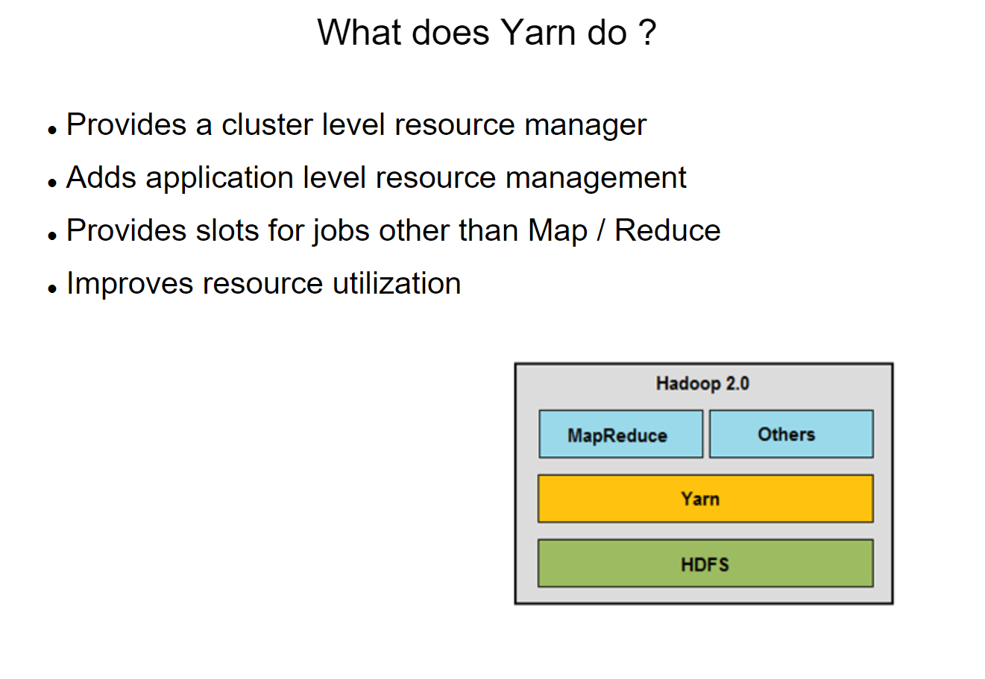

Slide 24
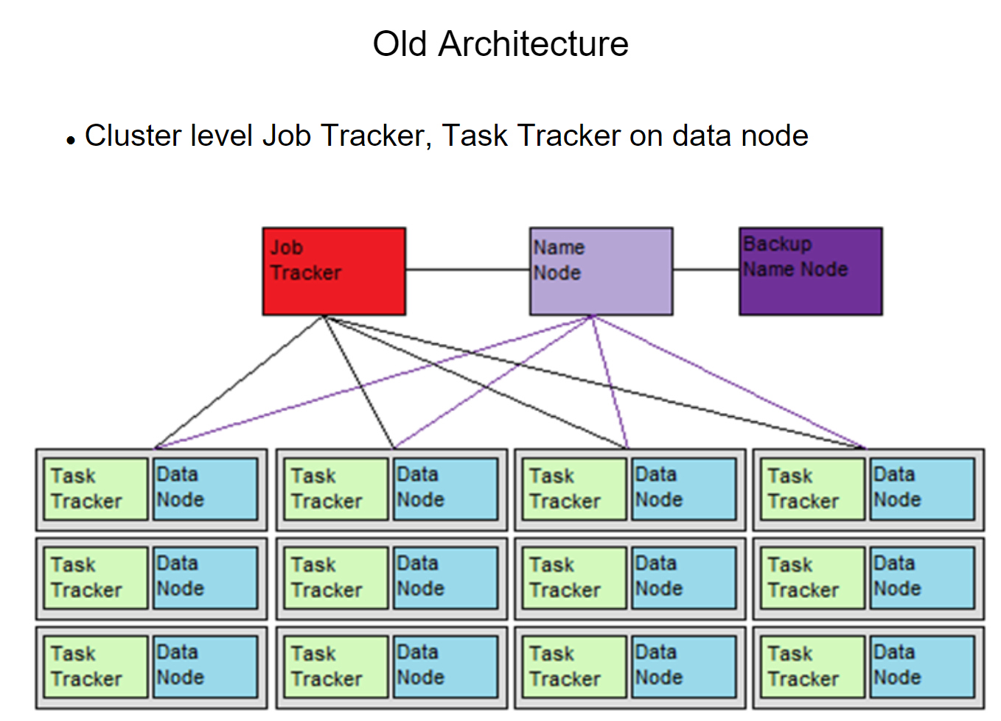

Slide 25
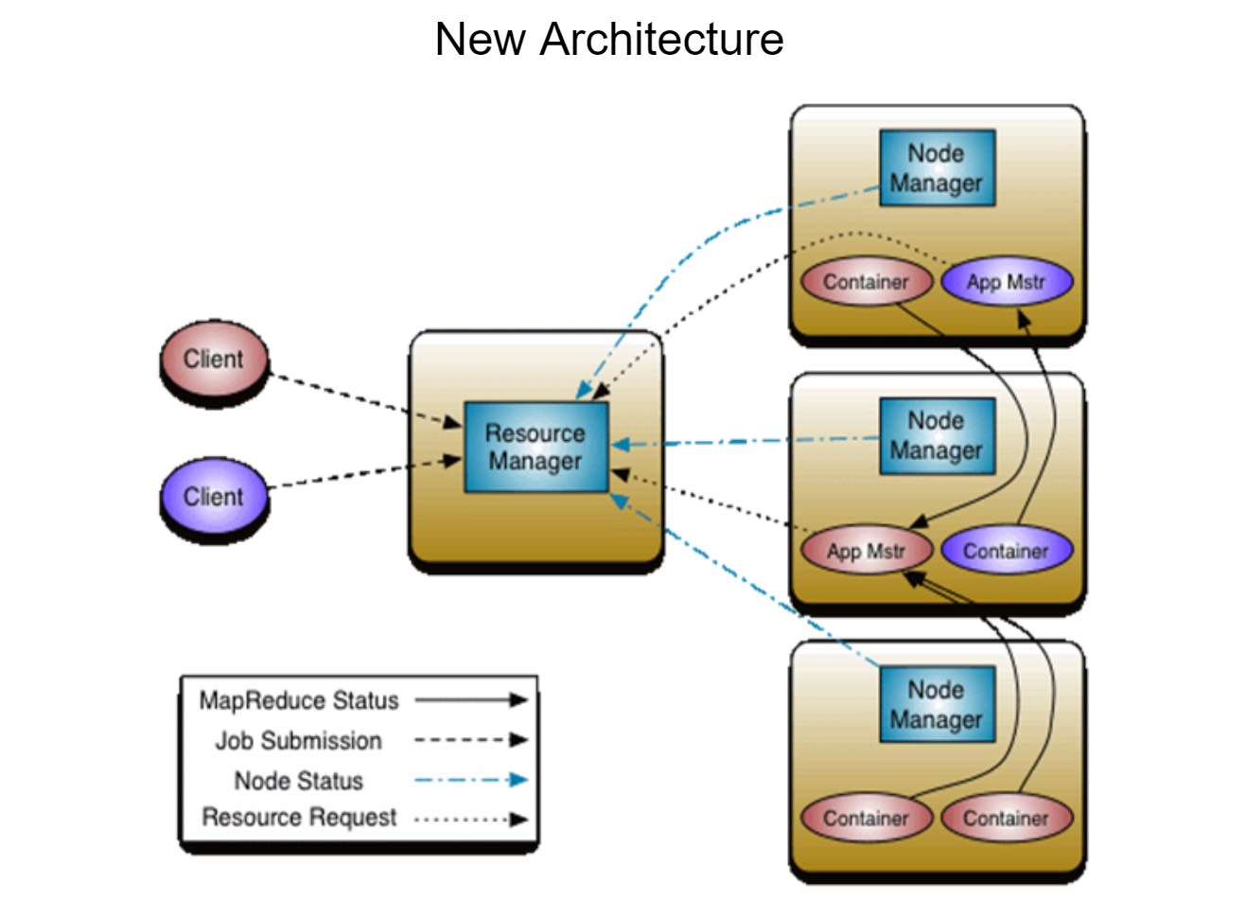

Slide 26
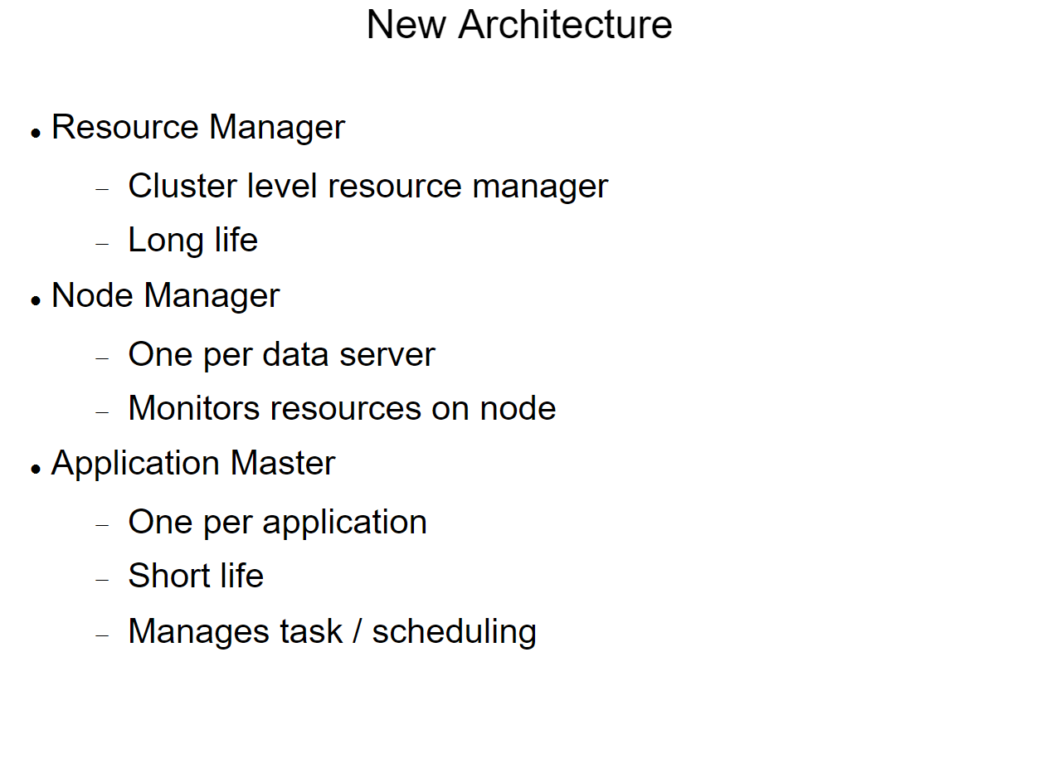

Slide 27
Apache YARN
Apache YARN (Yet Another Resource Negotiator) is Hadoop’s cluster resource management system.
YARN was introduced in Hadoop 2 to improve the MapReduce implementation
The Below diagram shows some distributed computing frameworks (MapReduce, Spark, and so on) running as YARN applications on the cluster compute layer (YARN) and the cluster storage layer (HDFS and HBase).

Slide 28
Anatomy of a YARN Application Run
YARN provides its core services via two types of long-running daemon:
a resource manager (one per cluster)
node managers
A resource manager (one per cluster) to manage the use of resources across the cluster.
Node managers running on all the nodes in the cluster to launch and monitor containers.
A container executes an application-specific process with a constrained set of resources (memory, CPU, and so on).
Depending on how YARN is a container may be a Unix process or a Linux cgroup

Slide 29
How YARN runs an application

Slide 30
How YARN runs an application
To run an application on YARN, a client contacts the resource manager and asks it to run an application master process.
The resource manager then finds a node manager that can launch the application master in a container.
It could simply run a computation in the container it is running in and return the result to the client. Or it could request more containers from the resource managers.
and use them to run a distributed computation

Slide 31
Job Scheduling
Early versions of Hadoop had a very simple approach to scheduling users’ jobs using a FIFO scheduler.
Each job would use the whole cluster, so jobs had to wait their turn.
Later on, the ability to set a job’s priority was added, via the “mapred.job.priority” property or the setJobPriority() method on JobClient.
When the job scheduler is choosing the next job to run, it selects one with the highest priority.
However, with the FIFO scheduler, priorities do not support preemption, so a high-priority job can still be blocked by a long-running low priority job that started before the high-priority job was scheduled.

Slide 32
Job Scheduling Cont..
MapReduce in Hadoop comes with a choice of schedulers.
The default in MapReduce1 is the original FIFO queue-based scheduler, and there are also multiuser schedulers called the Fair Scheduler and the Capacity Scheduler.
MapReduce 2 comes with the Capacity Scheduler (the default), and the FIFO scheduler.
The Fair Scheduler aims to give every user a fair share of the cluster capacity over time.
If a single job is running, it gets all of the cluster.
As more jobs are submitted, free task slots are given to the jobs in such a way as to give each user a fair share of the cluster.
Jobs are placed in pools, and by default, each user gets their own pool.
A user who submits more jobs than a second user will not get any more cluster resources than the second, on average.
The Fair Scheduler supports preemption, so if a pool has not received its fair share for a certain period of time, then the scheduler will kill tasks in pools.

Slide 33
Job Scheduling Cont..
The Capacity Scheduler:
The Capacity Scheduler takes a slightly different approach to multiuser scheduling.
A cluster is made up of a number of queues (like the Fair Scheduler’s pools), which may be hierarchical (so a queue may be the child of another queue), and each queue has an allocated capacity.
This is like the Fair Scheduler, except that within each queue, jobs are scheduled using FIFO scheduling (with priorities).

Slide 34
Shuffle and Sort
MapReduce makes the guarantee that the input to every reducer is sorted by key.
The process by which the system performs the sort—and transfers the map outputs to the reducers as inputs—is known as the shuffle.
The shuffle is an area of the codebase where refinements and improvements are continually being made, so the following description necessarily conceals many details.
In many ways, the shuffle is the heart of MapReduce and is where the “magic” happens.

Slide 35
Task Execution
The Task Execution Environment: Hadoop provides information to a map or reduce task about the environment in which it is running.
For example, a map task can discover the name of the file it is processing and a map or reduce task can find out the attempt number of the task.
It follows the properties mentioned below:

Slide 36
MapReduce types
The map and reduce functions in Hadoop MapReduce have the following general form:
map: (K1, V1) → list(K2, V2)
reduce: (K2, list(V2)) → list(K3, V3)
Where the map input key and value types (K1 and V1)
The map output types (K2 and V2) : these are different from input values
However, the reduce input must have the same types as the map output, although the reduce output types may be different again (K3 and V3).
The Java API mirrors this general form:

Slide 37
MapReduce types
The context objects are used for emitting key-value pairs, so they are parameterized by the output types so that the signature of the write() method is:
Since Mapper and Reducer are separate classes the type parameters have different scopes, and the actual type argument of KEYIN (say) in the Mapper may be different to the type of the type parameter of the same name (KEYIN) in the Reducer.
Even though the map output types and the reduce input types must match, this is not enforced by the Java compiler.
The type parameters are named differently from the abstract types (KEYIN versus K1, and so on), but the form is the same.
If a combine function is used, then it is the same form as the reduce function (and is an implementation of Reducer), except its output types are the intermediate key and value types (K2 and V2), so they can feed the reduce function:

Slide 38
Keys and values in Streaming
when the map or reduce writes out key-value pairs, they may be separated by a configurable separator.
Separators may be configured independently for maps and reduces. The properties are listed below:

Slide 39
Where separators are used in a Streaming MapReduce job?

Slide 40
Input Formats
Hadoop can process many different types of data formats, from flat text files to databases.
different such formats are available.
Input Splits and Records:
an input split is a chunk of the input that is processed by a single map.
Each map processes a single split.
Each split is divided into records, and the map processes each record—a key-value pair—in turn.
In a database context, a split might correspond to a range of rows from a table and a record to a row in that range
Input splits are represented by the Java class, InputSplit:
An InputSplit has a length in bytes and a set of storage locations, which are just hostname strings.

Slide 41
Input Formats
As a MapReduce application writer, you don’t need to deal with InputSplits directly, as they are created by an InputFormat.
An InputFormat is responsible for creating the input splits and dividing them into records.
The client running the job calculates the splits for the job by calling getSplits(), then sends them to the jobtracker, which uses their storage locations to schedule map tasks to process them on the tasktrackers.
On a tasktracker, the map task passes the split to the createRecordReader() method on InputFormat to obtain a RecordReader for that split.

Slide 42
InputFormat class hierarchy
all of the classes mentioned in this diagram , are available in the org.apache.hadoop.mapreduce package

Slide 43
Output Formats
Hadoop has output data formats that correspond to the input formats.
The OutputFormat class hierarchy appears below:

Slide 44
Output Formats
Text Output:
The default output format, TextOutputFormat, writes records as lines of text.
Its keys and values may be of any type since TextOutputFormat turns them to strings by calling toString() on them.
Binary Output:
SequenceFileOutputFormat: It writes sequence files for its output.
SequenceFileAsBinaryOutputFormat is the counterpart to SequenceFileAsBinaryInputFormat, and it writes keys and values in raw binary format into a SequenceFile container.
MapFileOutputFormat: MapFileOutputFormat writes MapFiles as output.
Multiple Outputs:
FileOutputFormat and its subclasses generate a set of files in the output directory.
There is one file per reducer, and files are named by the partition number: part-r-00000, part-r-00001, etc.
MapReduce comes with the MultipleOutputs class by default.

